Slide 1


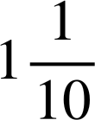
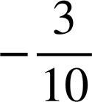
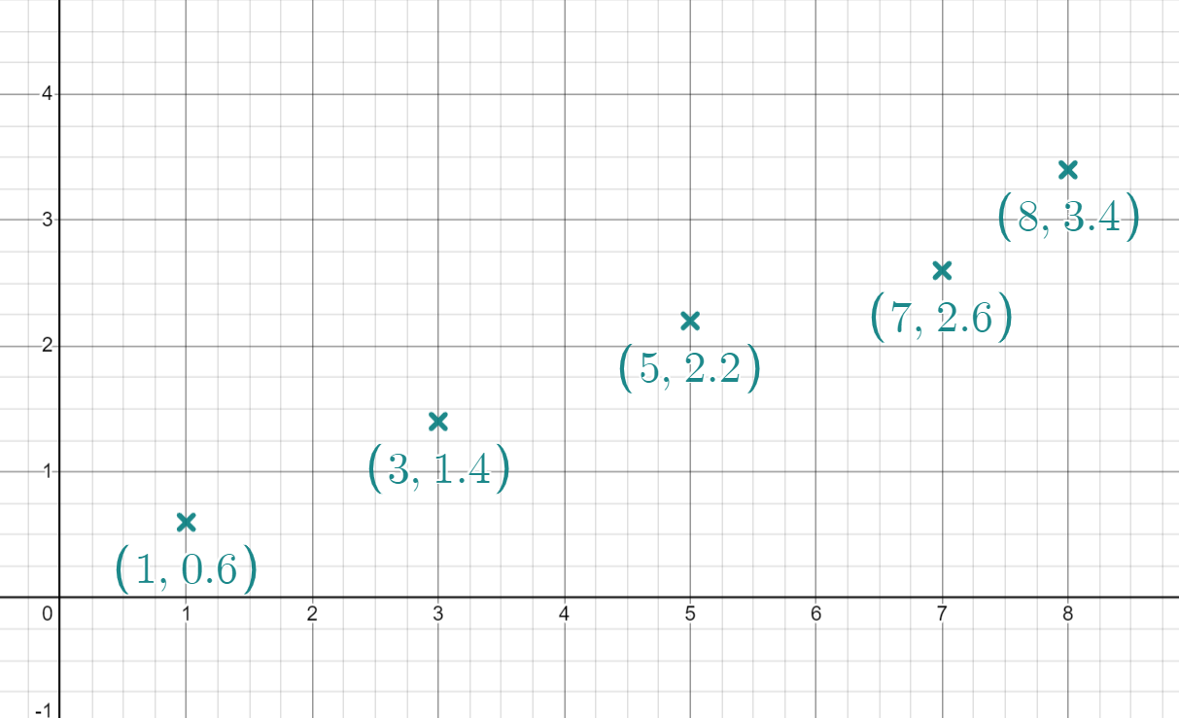
Plotting coordinates generated from a rule using technology
Task A: Plotting coordinates in Desmos
On your graphing software press the button if visible.
Change the step on your x axis to 3. Change the step on your axis to 4
What integer values do your axes range from and to?
Move your axis until you can see 28 on the axis. What is the next value visible below 28?
Press the button. Describe what this does to your axes.
Plot the coordinates (2,4) and (2,6). Plot a third coordinate so it is in the middle of these coordinates. What coordinate did you plot?
For most display screens the x axis will range from -9 to 9 and the y axis from -4 to 4
24
It centres the screen around the origin. It also changes the axis so they have the same scale (although the steps are still different)
(2,5)
Task B: Identifying coordinates that do not follow a rule
Plot each set of coordinates in turn. Identify the coordinate which is the odd one out.
(0,-4) (4,8) (1,-1) (2,6) (-2,-10)
(0,7) (4,4) (10,-2) (-1,9) (2,6)
(8,-1.4) (5,-1.85) (-4, 3.2) (12,-0.8) (-9,-3.95)
(11,2.9) (1, ) (-9,-1.1) (2, ) (-5, )
Izzy has plotted the coordinates below.
Which one do you think she has plotted incorrectly? How do you know?
(7,2.6) because it doesn’t sit on a straight line with the other 4 points
Recreate Izzy’s graph
make the incorrect coordinate draggable.
Drag the coordinate so it is in line with the rest and on a coordinate where both values are integers.
What coordinate have you now plotted?
b)
(7,3) or (2,1) There are other possibilities not visible on this graph

Slide 2
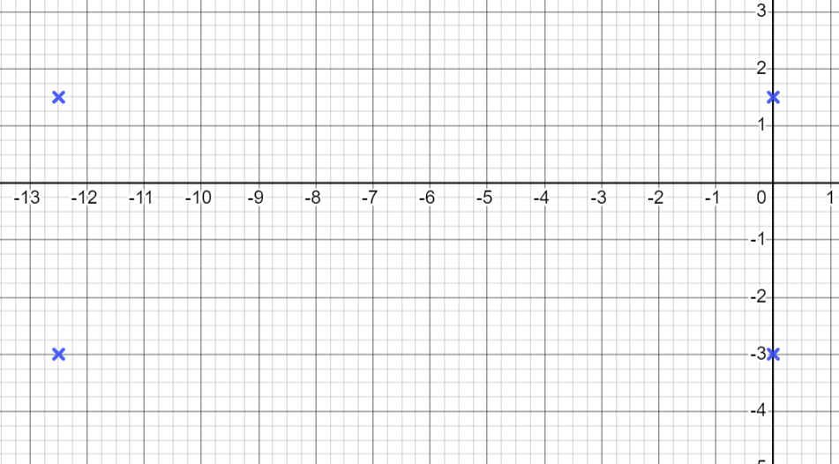
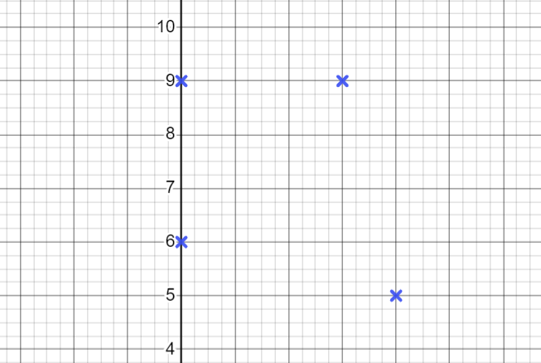
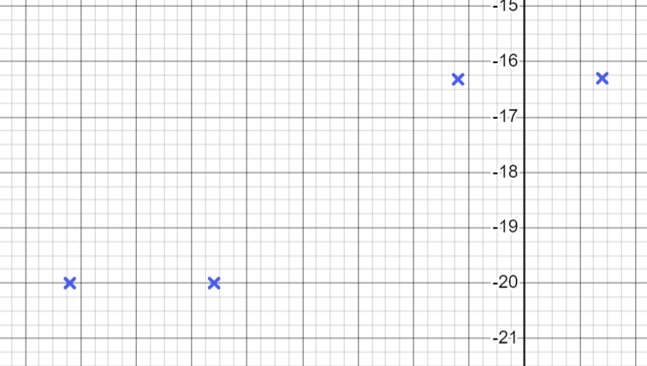
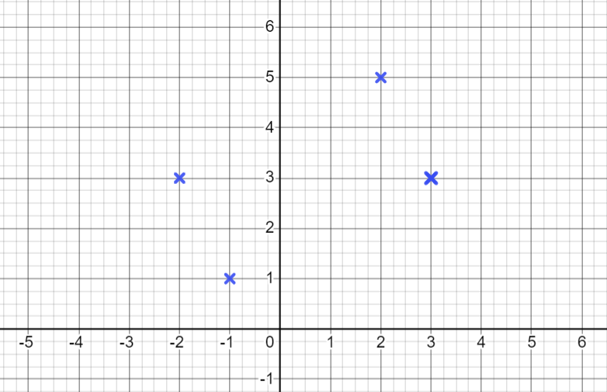
Plotting coordinates generated from a rule using technology
Task C: Creating shapes in desmos
For each set of coordinates, find the fourth coordinate to make a square
(0,0) (8,-2) (10,6)
(0,0) (4,5) (-1,9)
(0,0) (7,-3) (3,7)
(2,3) (-1,-4) (4,-2)
(-10,0.5) (-8,1.5) (-9,-1.5)
(2,8)
(-5,4)
(10,4)
(-3,1)
(-7,-0.5)
2) Plot each set of coordinates to determine the type of quadrilateral they make.
a) (-12.5,-3) (-12.5, 1.5) (0,-3) (0,1.5)
c) (0,9) (3,9) (0,6) (4,5)
Rectangle
Kite
b) (-8.2,-20) (1.4,-16.3) (-1.2,-16.3) (-5.6,-20)
d) (-2,3) (3,3) (2,5) (-1,1)
Parallelogram
Rectangle
Mathematics in Education and Industry
v2.2

